Slide 1

VARDHAMAN COLLEGE OF ENGINEERING, HYDERABAD
Autonomous institute affiliated to JNTUH
DEPARTMENT OF COMPUTER SCIENCE & ENGINEERING
Title: Eye Ball Cursor Moment Using DeepLearning
BATCH ID : 19CSPW-B8
S. No | Roll. No | Student Name
1 | 19881A05B4 | TELUKUNTLA SHARMILI
2 | 19881A05B5 | VALLEPU SRINIVAS
3 | 19881A05B6 | VANGAPALLY UMESH
Guide Details
Dr. G. Suryanarayana
Professor
Department of CSE

Slide 2
Major Project-Outlines
Main idea of the Project
Existing System Vs Proposed
Proposed Project Objectives
Proposed Project Outcomes
Process Model
Architectural Diagram
Software and Hardware Requirements
Summary of First Review
MAJOR PROEJECT

Slide 3
Main idea of the Project
In India approximately 3 % of people are handicapped and paralyzed,as we see that technology is rapidly increasing .
So, we decided to make an application where every human being able to operate the computer system with the help of his eyes.
Based on the eye ball moment we have deployed an application where the user can perform operations.
We have used the deep learning model such as Convolutional neural network for performing the application.
MAJOR PROEJECT

Slide 4
Existing System Vs Proposed
EXISTING SYSTEM:
At present the existing systems provide only the cursor moment with the help of the eye ball.
PROPOSED SYSTEM:
In our application not only the cursor moment but also we can perform the right click and left click operations so that it makes the user more convinient to use the computer system.
MAJOR PROEJECT

Slide 5
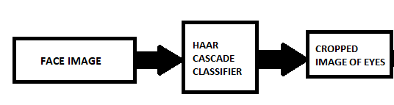
Proposed Project Objectives
We have created a dataset with multiple eyes images by using haar- cascade classifier.
This classifier crops the eye images from the face.
And then we create a Convolutional Neural Network (CNN) model.
And we have trained the model using the eye images.
MAJOR PROEJECT

Slide 6
Proposed Project Outcomes
The model try to detect the eyes whether the eyes are detected or not, if detected the eyes are cropped and eye aspect ratio(EAR) is calculated.
Then Based on eye ball movements the cursor will be moved to a particular pixel value.
This leads to easy use of computers for handi-capped persons.
The users can directly interact with the Stream lit interface and can use their computer systems.
MAJOR PROEJECT

Slide 7
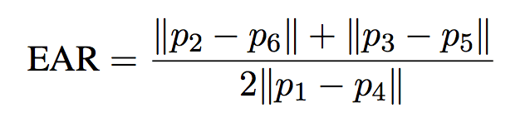
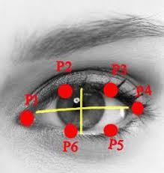
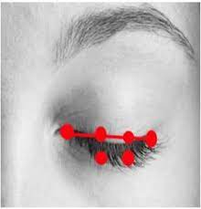
EAR (Eye Aspect Ratio)
A threshold value of 0.2 is established in our software to employ EAR in eye tracking and cursor movement to identify whether the user's eyes are open or closed.
MAJOR PROEJECT

Slide 8
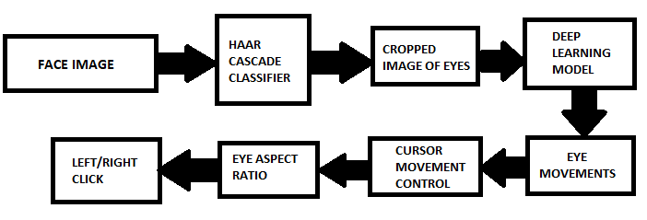
Process Model
MAJOR PROEJECT

Slide 9
Software and Hardware Requirements
HARDWARE REQUIRMENTS:
  Laptop or PC
    I7 processor system or greater processor system
    8 GB RAM or greater RAM
    100 GB ROM or greater ROM
SOFTWARE REQUIRMENTS:
  Languages
    Python
  Frameworks and Libraries:
    Py-auto gui
    Open CV
    Haar cascade classifier
MAJOR PROEJECT

Slide 10
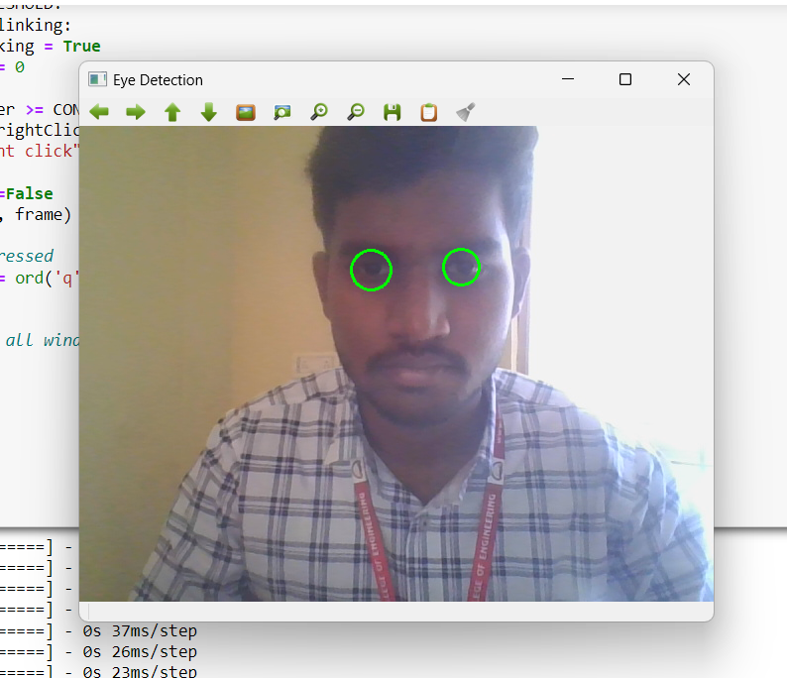
Results
MAJOR PROEJECT

Slide 11
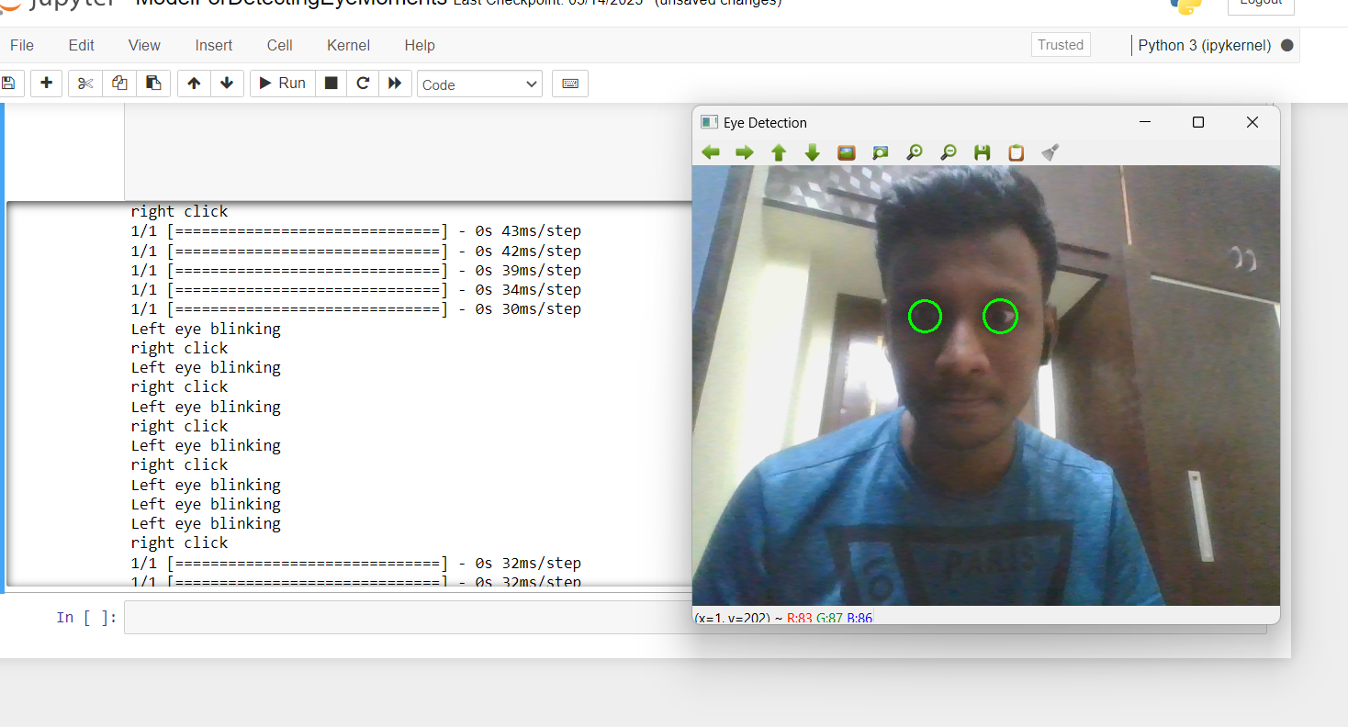
Results
MAJOR PROEJECT

Slide 12
Conclusion and Future Scope
As our aim is to control computer with eyes. We are looking to implement few other operations which can be done by mouse.
Other than click operations there are scrolling operation, selection of text and typing.
For typing we are trying to invoke a virtual keyboard and the letters that are clicked will be displayed on the notepad or other blank screen.
We are looking forward to generalize the cursor control to the remote controlling of televisions or any other software.
For this we need an hardware device which will do the whole thing at once and perform the task at ease.
A specs or something with a camera inbuilt and the whole process running can make the daily life easier and interesting.
MAJOR PROEJECT

Slide 13
Thank You
MAJOR PROEJECT

